Slide 1
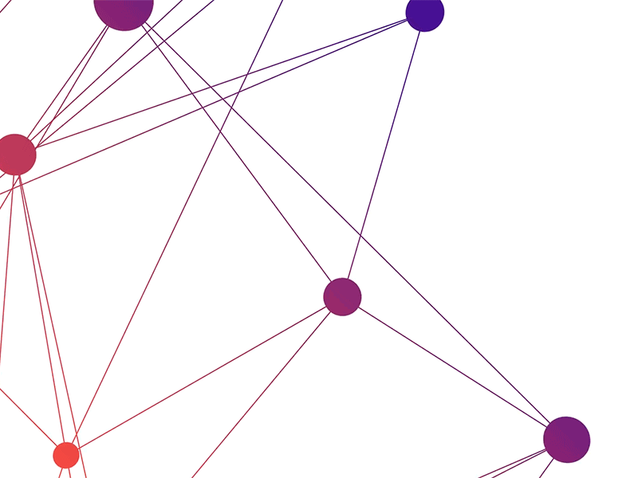

Alphabot
INNOVATING SIMPLICITY

Slide 2

TEAM
Guided By: Prof. Kamlesh Makvana
16IT029 | Palak Jadhav
16IT030 | Huzefa Jambughodawala
16IT043 | Smit Ladani
16IT059 | Kashyap Nirmal
IT 345 – (Software Group Project II)

Slide 3
What is Alphabot?
What is what? How much? When? Who? Where is what? When did? What will? What is what? How much? When? Who? Where is what? When did? What will?
Able to solve queries in its initial stages.
More specifically, academic queries.
Being developed to be able to replace the ChatBot on CHARUSAT University’s official website.

Slide 4
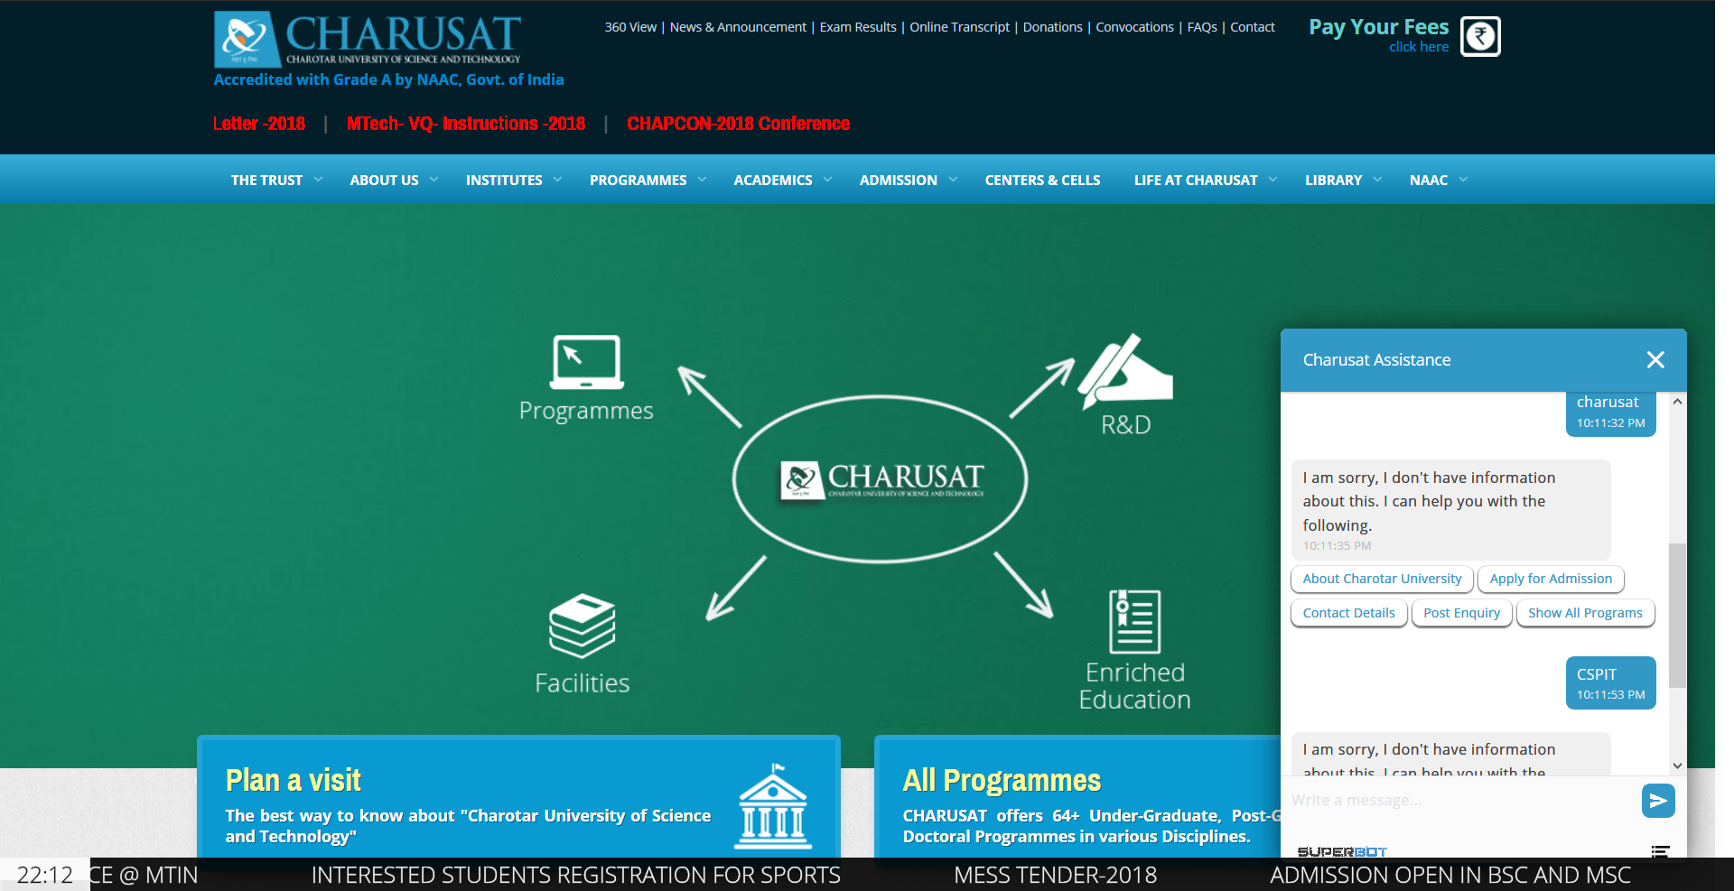

Slide 5
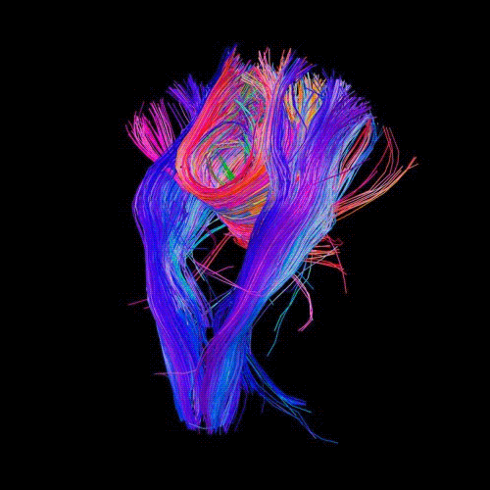
Dataset
Collect user IP & other info.
Query
Parsing
Token already in dataset?
Calculating response & Adding it
YES
[Project Flowchart]
NO
Retrieving
Text to Speech
Response

Slide 6

Modules
Speech Recognition.
Query Processing & Dataset.
Networking.
Front-end UI

Slide 7
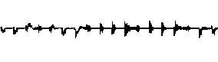
Speech Recognition

Slide 8
Status
Working on Speech to Text conversion
Machine independency for Text to speech module

Slide 9
Technologies used
Python
Libraries like Pyttsx3 and Pyaudio
Learnt/Learning
Python Documentations (Learning python)
Neural networks course (Udemy)
Problems
Machine dependency errors for Text-to-speech module.
Setup of portaudio.h (microphone of device) with Program for Speech-to-text conversion.
Probable solutions:
Resolving errors.
Compiling portaudio.h using Visual Studio.

Slide 10

Demo
Actual:
the stale smell of old beer lingers it takes heat to bring out the odor a cold dip restores health and zest a salt pickle taste fine with ham tacos al Pastore are my favorite a zestful food is the hot cross bun
Processed:
just a small boat beer drinkers it takes heat to bring out the order hold up research help in that case of pickles is fine with him because of astora my favourite is just for food is Bihar cross bun

Slide 11

Query Processing and dataset

Slide 12
Status:
Implemented Cosine Similarity for query processing

Slide 13
Technologies used
Python
SQLite3
NLTK Library
Collection Library
Learnt/Learning
Cosine Similarity
Machine Learning Course
Problems
If word has same probability then answer we get from bot is not as expected.
Abbrevation problem (e.g. IT (Information Technology) is consider as it which is removed by stopwords )
Probable solutions:
We will implement concept similar to Inverse Document Frequency (IDF) model to increase the efficiency of query processing.

Slide 14
Status:
Dataset created.
Query parsing, recognition taking decision
thorough dataset training(to be done)

Slide 15
Technologies used
csv
PorterStemmer, stopwords (from nltk)
sqlite3
re
Learnt/Learning
Dataset Generation
Algorithm Design and Analysis MOOC Course
Machine Learning MOOC Course
Problems
if input contains some irrelevant words and some known words, then also an answer will be provided eg. ‘Fees of Textile Engineering’
Probable solutions:
Implementing a smoothing process(mostly Dirichlet Smoothin Or Jelinek-Mercer Smoothing) deals with a word that is not relevant

Slide 16

Networking

Slide 17
Live IP-details
Used to keep the track of the users according to the regions. It is helpful for various educational institutes for their promotions i.e Admission Seminars.
Notes:
Similarity:
To find the similarity between two words.Using the Wordnet.
Synonyms:
To find the synonyms of the word.Using the Wordnet.

Slide 18
Learnt
Introduction to NLP.
RASA NLU.
Problems
-The word is not found within our dataset.
-There are any mispells.
Probable Solution
-If the word is not listed in our dataset then we might go for searching the synonyms and the similarity.
-To avoid mispells we might use the RASA NLU.

Slide 19

Front-end ui

Slide 20
Technologies used
HTML
BOOTSTRAP 4
CSS
JAVA-SCRIPT
DJANGO

Slide 21

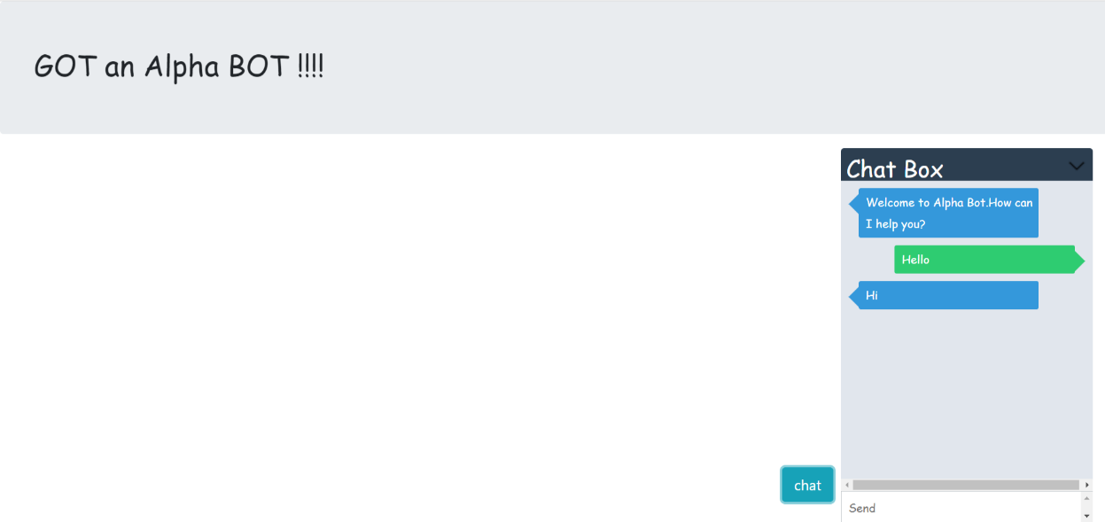
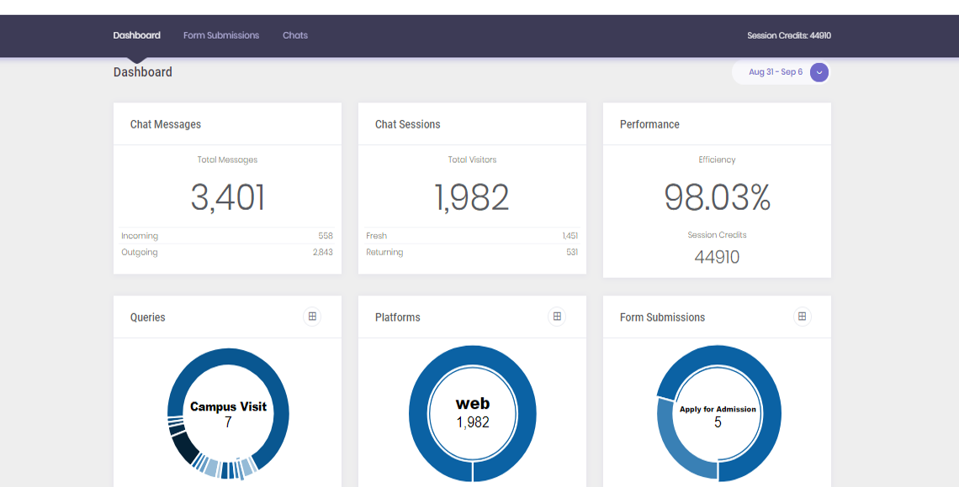
UI

Slide 22

Thank you!

